Slide 1


Bank System (Client-Server)
Secure Bank System: Client-Server Using Qt Sockets

Slide 2

Introduction

Slide 3

Purpose of the Project
Develop a Strong and secure banking system.
Handle multiple client requests efficiently.
Provide essential banking operations for both admins and users.

Slide 4
Overview
Comprehensive client-server application for banking operations.
User-friendly GUI built with Qt/C++ for client applications.
Strong server application handling multiple client requests using threads.
Supports admin and user roles with distinct functionalities.
Securely stores user data and transaction logs using JSON files.
Encrypts requests for secure communication.
Includes logging, service integration, and email responses.

Slide 5
Architecture

Slide 6
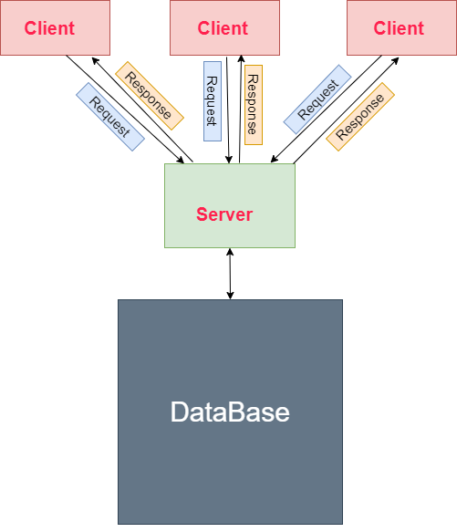
Basic Architecture
The Bank System is designed with a Strong client-server architecture to handle multiple client requests efficiently and securely.
1. Client Application.
2. Server Application.
3-DataBase.

Slide 7
Client Application
GUI Application built with Qt/C++
User Roles: Supports both admin and user roles
Encryption for secure communication
Uses sockets to connect to the server

Slide 8
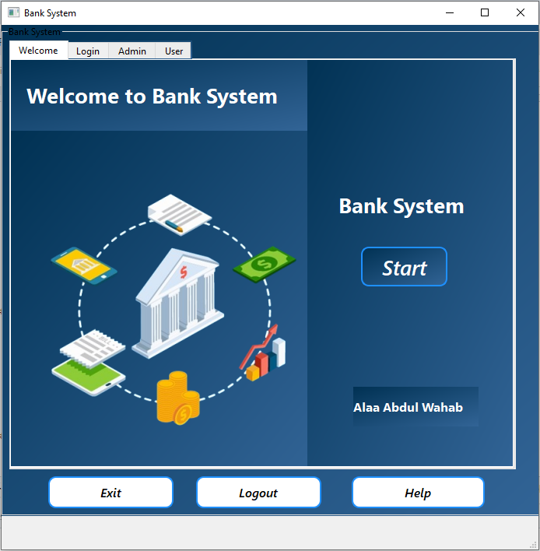
Client GUI Interface

Slide 9
Server Application
Console-based application.
Utilizes multithreading to handle multiple client connections.
Processes various banking operations (e.g., account management, transactions).
Uses JSON files for storing user data and transaction logs.

Slide 10
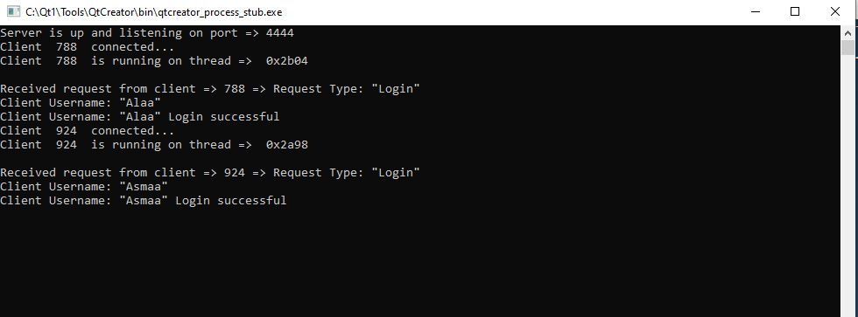
Server : console application

Slide 11

Server as a Service
Purpose: Ensures the server runs automatically in the background when the system starts.
Benefits:
Automatic Start: Server starts with the operating system.
Background Operation: No manual start required.

Slide 12

Database
The database in the Bank System serves as the central repository for storing all information about users and their transactions.
It is designed to be secure, efficient, and easily accessible.
Ensures that both admin and user roles can perform their respective operations seamlessly.
The database consists of two main components:
User Data File: Stores user information.
Transaction Data File: Records user transactions.
Both components are stored in JSON format for simplicity and ease of management.

Slide 13
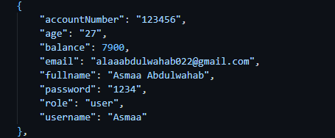

User Data

Slide 14
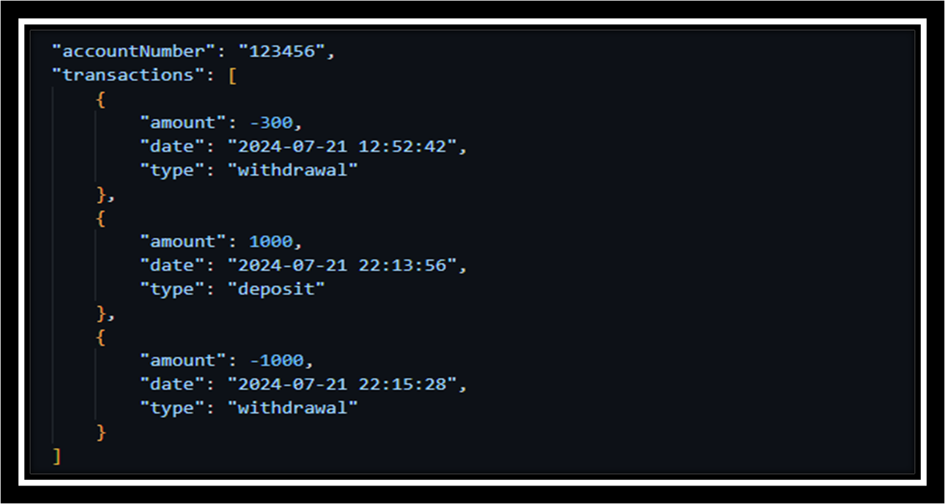
Transaction Data

Slide 15

Diagrams

Slide 16
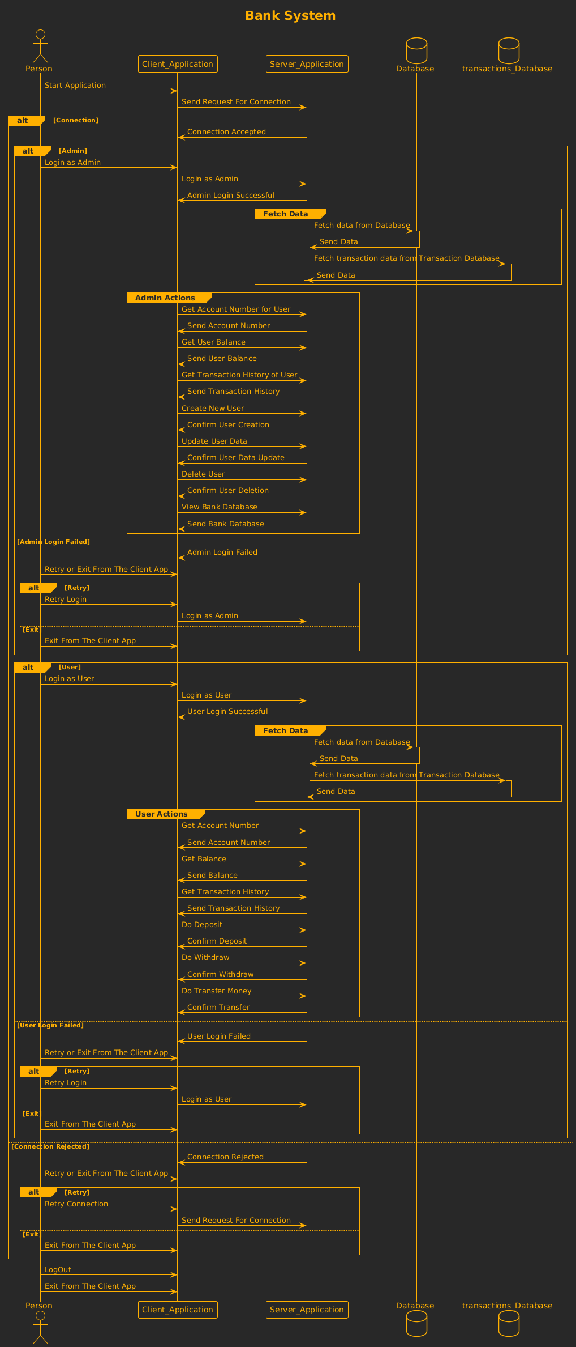
Sequence diagram

Slide 17
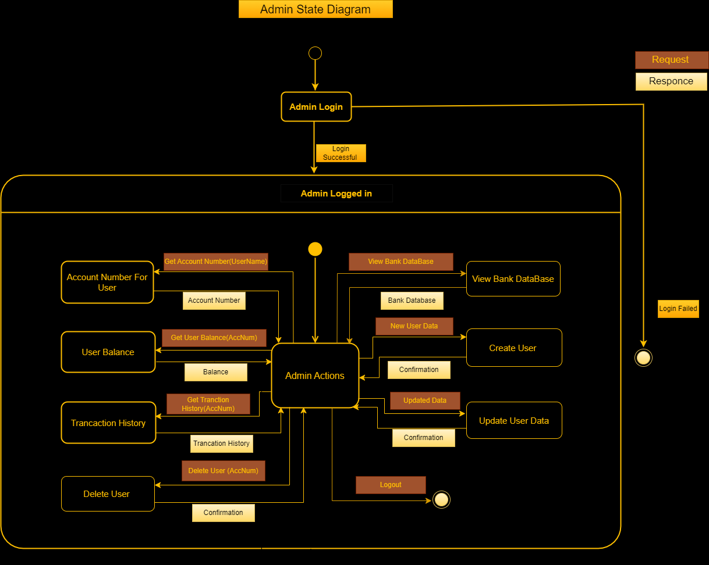

Admin state diagram

Slide 18
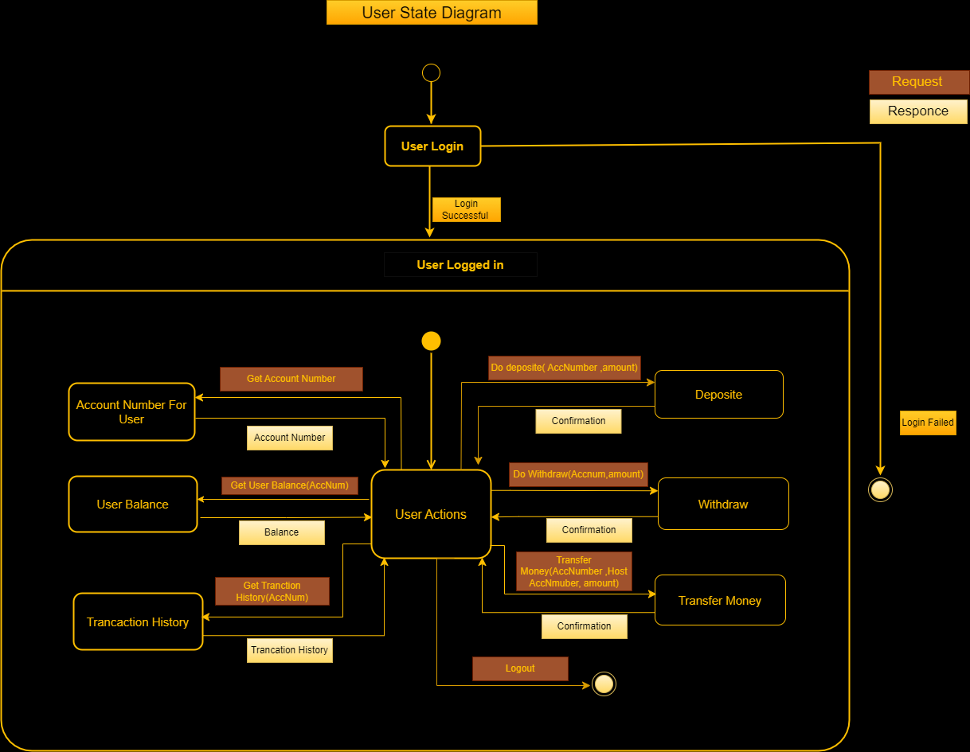
User state diagram

Slide 19
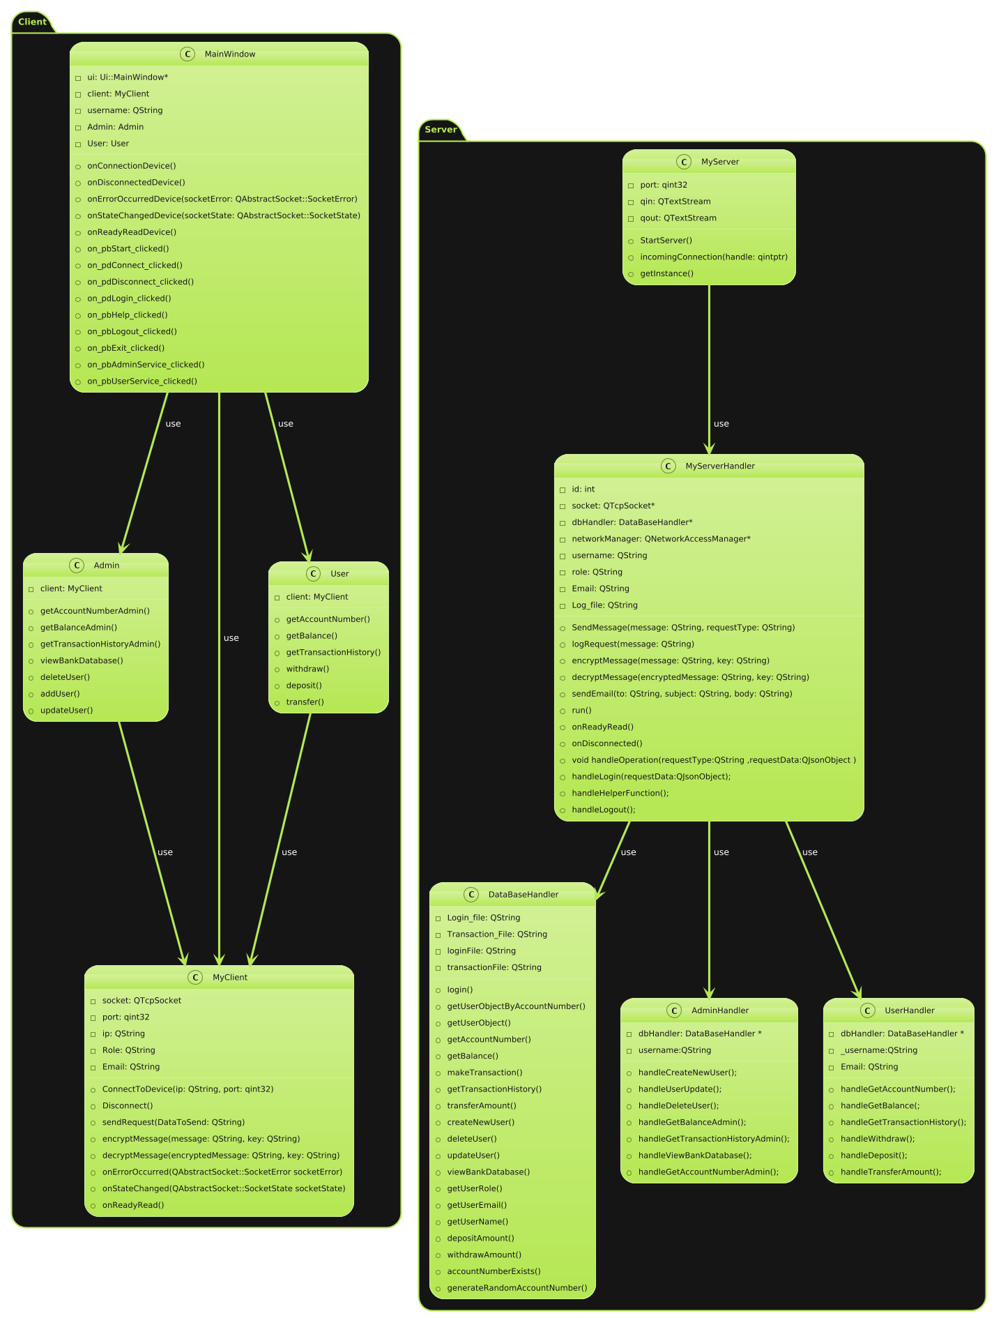
Class diagram

Slide 20

Design patterns
Singleton Pattern: Used to create a single server instance.
Observer Pattern: Used for updating views in response to data changes in client side.
Facade Pattern: Simplifies interaction with complex subsystems.
“Server” class acts as a facade to subsystems like Admin and User.

Slide 21

Communication

Slide 22
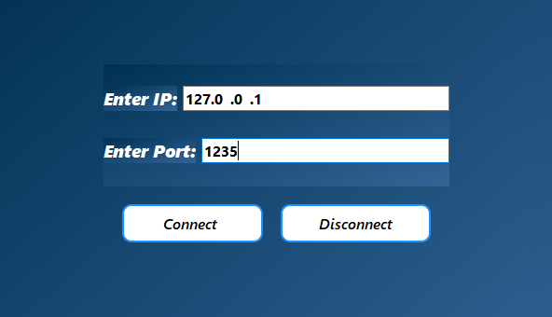
1-Client Initiates Connection
The client application starts and sends a connection request to the server
Specifies server's IP address and port number.
Server listens for incoming connection requests on a specified port.

Slide 23
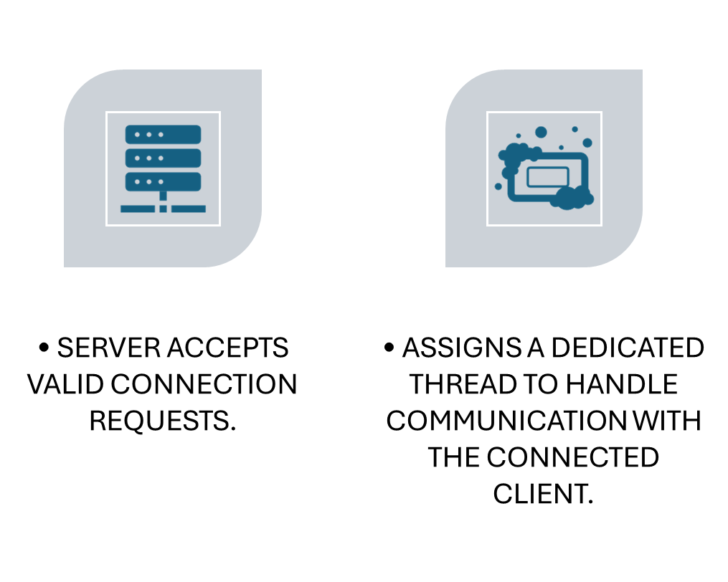
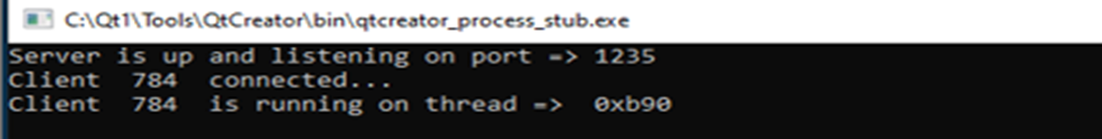
2- Server Accepts Connection

Slide 24
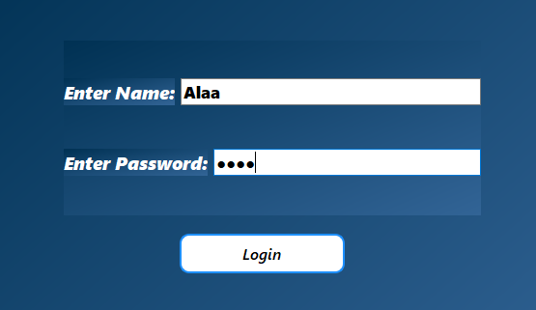
3-Authentication
Client sends login credentials (username and password) to the server.
Server verifies credentials by checking the user data file (JSON).
Determines the role (admin or user) and grants access accordingly.

Slide 25
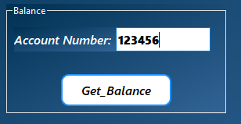
4-Request Handling
Client sends requests to the server to perform various operations (e.g., view balance, transfer money, etc.).
Each request is processed by the server.
Server retrieves or updates information from the user data file or transaction data file as needed

Slide 26
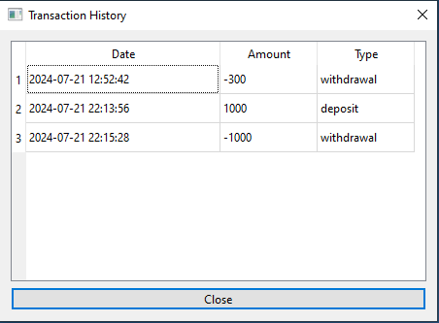
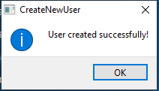
5-Response to Client
Server sends an appropriate response back to the client after processing the request.
Response may include requested data (e.g., account balance, transaction history) or confirmation of actions (e.g., successful deposit, user creation).

Slide 27

6-Data Encryption
Ensures secure communication by encrypting data exchanged between the client and server.
Uses signature to verify the integrity and authenticity of the data, ensuring that it has not been altered during transmission.

Slide 28
Data from client to server
Before Encryption
After Encryption

Slide 29

Data from Server to Client
Before Decryption
After Decryption

Slide 30
Encryption and Decryption
Using Self-Inverse Algorithm and Asymmetric Key.
An algorithm is self-inverse if applying it twice returns the original input.

Slide 31
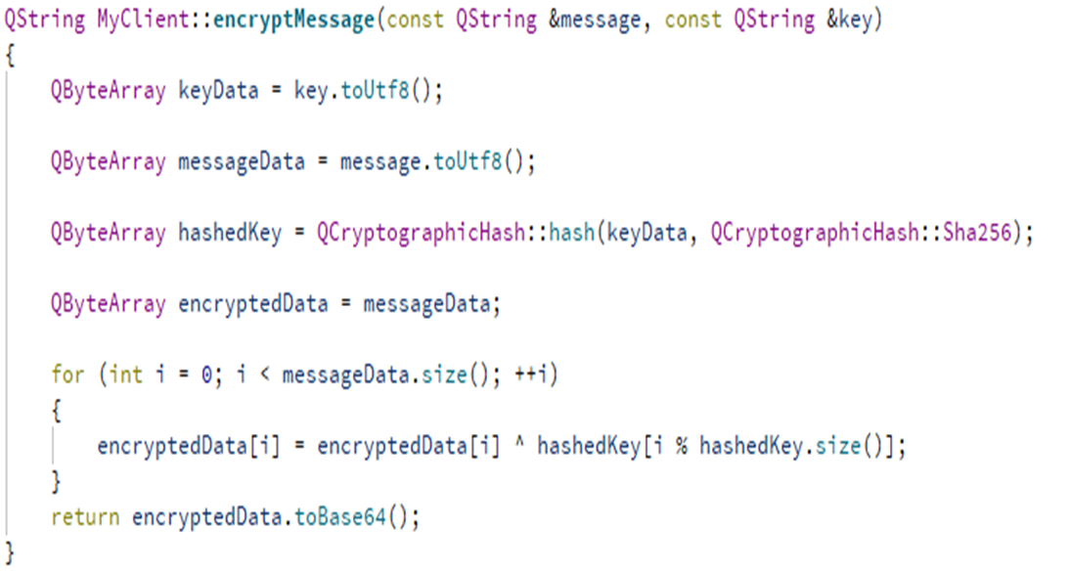
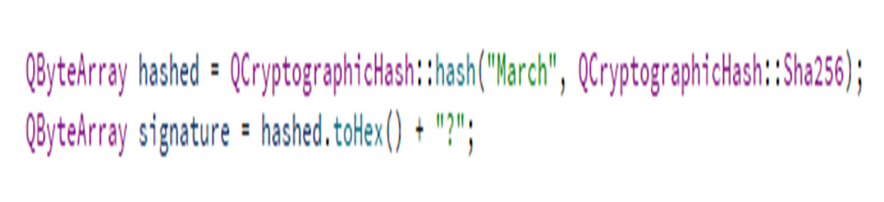
Code Encryption
Encryption:
The message is first converted to a byte array.
A key (e.g., "March") is hashed using SHA-256 to produce a 32-byte hashed key.
The message byte array is XOR-ed with the hashed key to produce the encrypted data.
The encrypted data is then encoded in Base64 for transmission.
Signature:
Verifies Data Authenticity
Confirms the origin of the data.
Uses a specific key to ensure the data is from a trusted source.

Slide 32
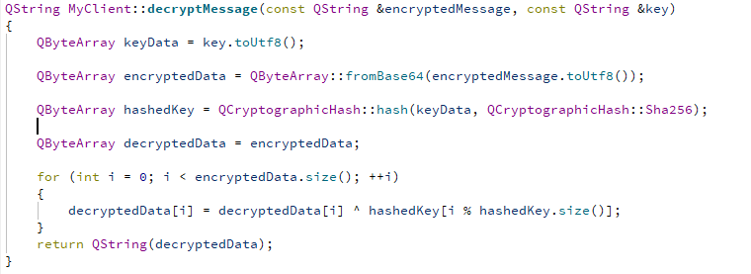
Code Decryption
Decryption:
The encrypted message is decoded from Base64 to a byte array.
The same key is hashed again using SHA-256 to produce the same 32-byte hashed key.
The encrypted byte array is XOR-ed with the hashed key to retrieve the original message byte array.
The original message byte array is converted back to a readable string.

Slide 33
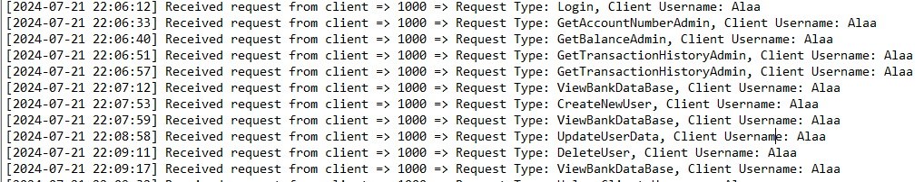
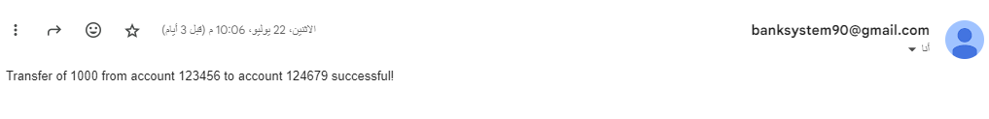
7-Logging and Send Email
Server logs all requests and actions in a log file for auditing purposes.
Users can receive email confirmations for specific actions, like successful transfers or successful Deposit or withdraw.

Slide 34

Thank you

